Slide 1

Group
participation
part 2
ME AND THE BOIZ
Week 10 progress
Week 11

Slide 2
What we have done?
Modify report
Consultation
Web build
Convert report to slide
Update game function
ME AND THE BOIZ

Slide 3
Modify report
Spelling and grammar
We checked grammar and spelling mistakes in the report manually combined with Grammarly tools
Bao and Duy has modified the report to check for mistakes
Word choice
We checked if we have used formal and suitable vocabulary.
We have removed some inappropriate phrase.
CHECKING PROGRESS
Meanings
We checked whether the paragraphs are stick to the project idea
Satisfaction to the canvas
We checked if the report was satisfied with the demand in canvas and executed some further feature on the rubric

Slide 4
Consultation
We booked a meeting with Mr. Duy- our lecturer for asking some relevant questions.
ME AND THE BOIZ

Slide 5
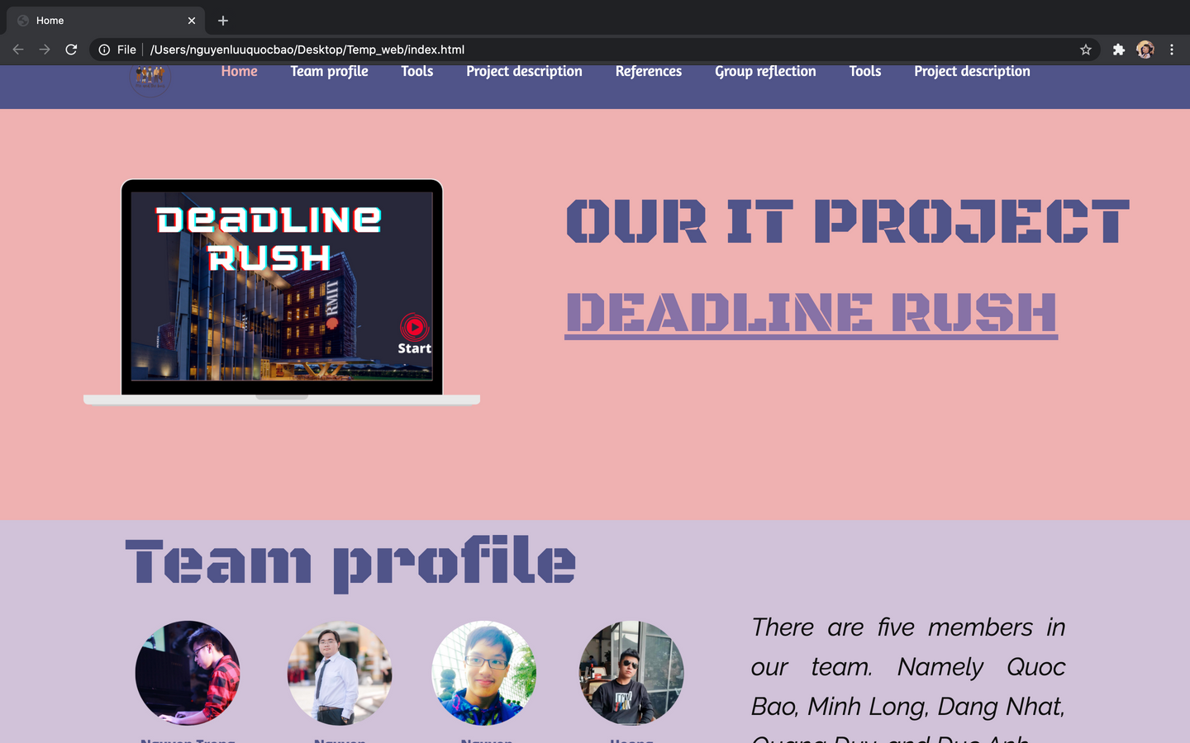
Web build
This task is assigned to Bao and Long.
So far, they have built the home page and the menu
ME AND THE BOIZ

Slide 6
Menu
Display a menu for user to select which part to see
Home page
A home page for overviewing of all parts
Additional page
Some more detailed sections for further study
WEB BUILDING PROGRESS
Button
Button to link the home page to another page and reversely
Animation
Put some animation for avoiding boring
Modification
Finally adjust the web for launching

Slide 7
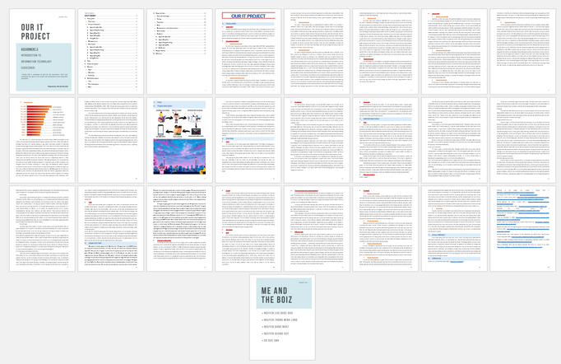
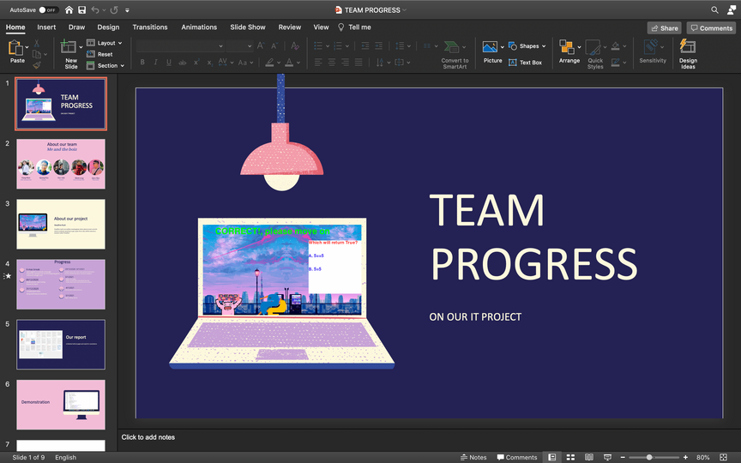
Convert report to slide
This stage is crucially important for presentation
ME AND THE BOIZ

Slide 8
Titles
Contents
We will convert the titles to the slides as this is the overview of each part of the reports.
This helps the audience to have a general understanding of the topic
We will shorten the contents into small text for adding to the slides
We will not put the whole text of the report to the slides
Bullet devision
Images
We will put each small keyword and text into bullet points
This helps audiences follow the presentation easily
We will add some image for illustration, which makes the presentation more lively and practical

Slide 9
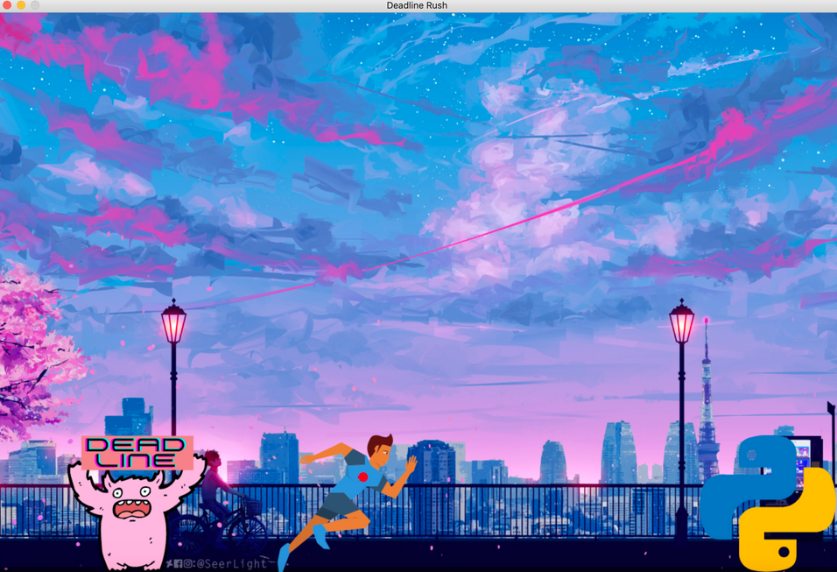
Update game functions
We updated the game to increase the users' experiencences
ME AND THE BOIZ

Slide 10
1. Main loop
6
Advanced
functions
The main loop is the most important elements as the game cannot run without the main loop
5
2.Player movement
Animations
The player will move base on the keystrokes
3. Core functions
4
Questions database
Including quit, restart, and pause
4. Questions database
3
Core functions
A library for poping the questions while main loop
5. Animations
2
Player movement
These elements are for attract players and avoid dull emotions
6. Advanced functions
1
Some further functions such as export learning chart, change the mode to challenge or nightmare, or relax mode.
Main loop

Slide 11
Q&A
ME AND THE BOIZ

Slide 12
Thank you for your attention!

